Slide 1
DNA and RNA as Genetic Material
I M. SC Biotechnology

Slide 2
Important Early Discoveries
1869 Johann Fredrich Miescher discovered DNA
1900 Chromosomes shown to contain hereditary information, later shown to be composed of protein & nucleic acids.
1928 Griffith’s Transformation Experiment
1944 Avery’s Transformation Experiment
1953 Hershey-Chase Bacteriophage Experiment
1953 Watson & Crick propose double-helix model of DNA
1956 Gierer & Schramm/Fraenkel-Conrat & Singer
Demonstrate RNA is viral genetic material.

Slide 3
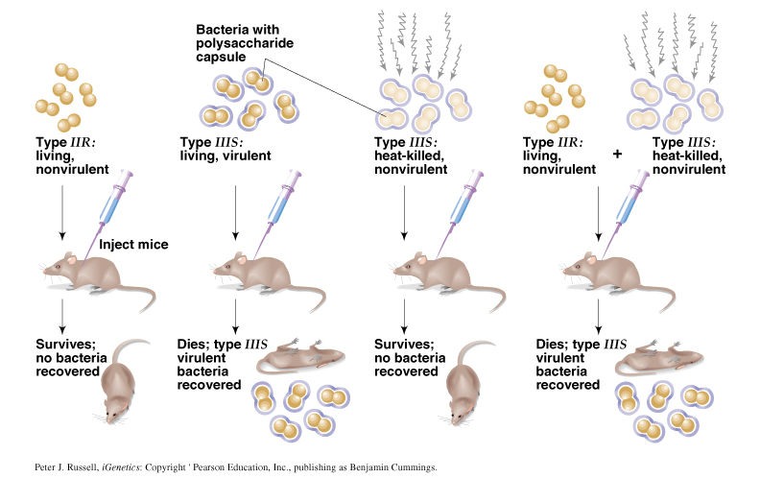
Frederick Griffith’s Transformation Experiment - 1928
“transforming principle” demonstrated with Streptococcus pneumoniae

Slide 4
Avery, MacLeod and McCarty Experiment

Slide 5
Hershey-Chase Bacteriophage Experiment

Slide 7
Conclusions about these early experiments
Griffith 1928 & Avery 1944:
DNA is transforming agent.
Hershey-Chase 1953:
DNA (not protein) is the genetic material.
Gierer & Schramm 1956/Fraenkel-Conrat & Singer 1957:
RNA (not protein) is genetic material of some viruses.

Slide 8
The Central Dogma
The central dogma of molecular biology describes the flow of genetic information in cells from DNA to messenger RNA (mRNA) to protein.
It states that genes specify the sequence of mRNA molecules, which in turn specify the sequence of proteins

Slide 9
Viral Genome
Viral genomes are diverse in size, structure, and nucleotide genome composition.
They can be linear or circular molecules of dsDNA, ssDNA, dsRNA or ssRNA and they can be either segmented or non-segmented.
Single-stranded genomes may be wholly positive (gene-coding) or negative (anti-coding) sense, or may combine regions of both.

Slide 10
Types
Baltimore classification of viral genomes
Viruses can be grouped according to the properties of their genome

Slide 11
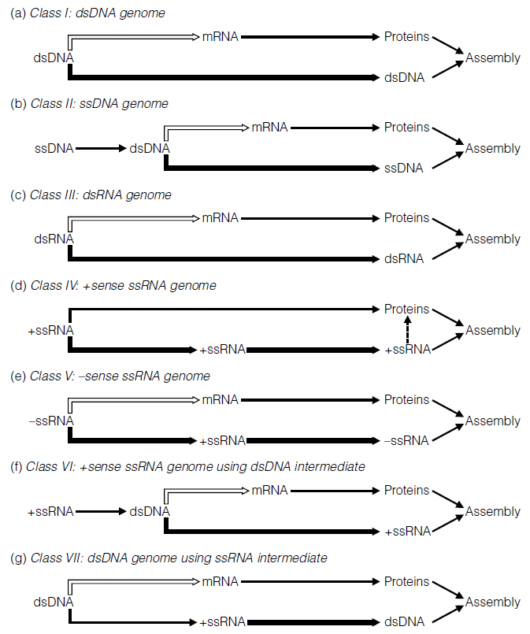
The Baltimore classification identifies several routes by which viruses with different genome compositions achieve mRNA transcription (shown as open arrows) and genome replication (thick arrows)

Slide 19
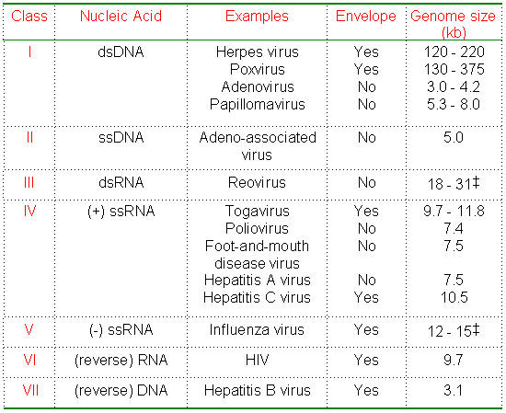

Slide 20
Structural organization of Prokaryotic and Eukaryotic cells.

Slide 21
Differences

Slide 23
C value paradox
C-value is the amount of DNA contained within a haploid nucleus (e.g. a gamete) or one half the amount in a diploid somatic cell of a eukaryotic organism.
C value paradox - the amount of DNA in the haploid cell of an organism is not related to its evolutionary complexity.

Slide 24
Eukaryotic organisms appear to have 2-10 times as many genes as prokaryotes,
Furthermore, the amount of DNA per genome is correlated not with the presumed evolutionary complexity of a species
The amount of DNA is not correlated with the number of chromosomes

Slide 25
Species kb/genome
E. coli 4.5 x 10³
Human 3.0 x 10⁶
Drosophila 1.7 x 10⁵
Maize 2.0 x 10⁶
Arabidopsis 7.0 x 10⁴
Lily 1.0 x 10⁸

